Slide 1
Trending-Video History on YouTube
November 14th, 2017 – June 14th, 2018

Slide 2
Table of contents
The purpose of the study - Slide 3
General Conclusions - Slide 4
Trending History - Slide 5
Trending History, % - Slide 6
Trending Videos by Country - Slide 7
Trending by Country and Category - Slide 8
Conclusion - Slide 9

Slide 3
The purpose of the study
The purpose of the study is to analyze trending videos on YouTube to determine what content deserves marketing attention. We will look at-
Which video categories trended most often?
How were they distributed among regions?
What categories were especially popular in the United States? Were there any differences between the categories popular in the US and those popular elsewhere?

Slide 4
General Conclusions
Entertainment, People & Blogs and Music are the video categories that trended most often.
The United States constitutes the highest percentage of YouTube video views
The most popular YouTube video category in the united states is Entertainment

Slide 5
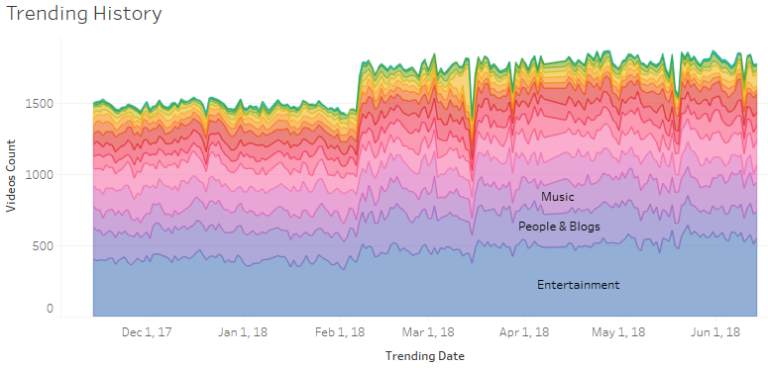
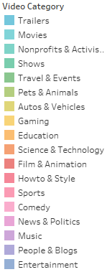
Entertainment, People & Blogs and Music are the video categories that trended most often
Entertainment is the #1 category of videos that trended on YouTube most often, followed by People & Blogs and Music.

Slide 6
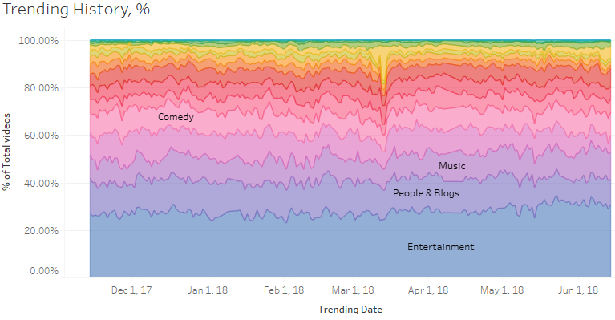
Entertainment, People & Blogs and Music are the video categories that trended most often
Entertainment constitutes the highest percentage of videos that trended on YouTube most often, followed by People & Blogs and Music.

Slide 7
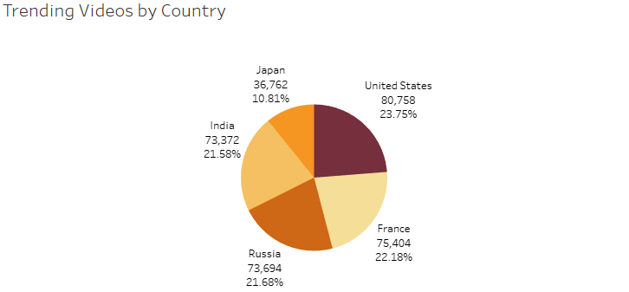
The United States constitutes the highest percentage of YouTube video views
The United States constitute 23.75% of all trending video views, followed by France with 22.18% and Russia with 21.68%

Slide 8
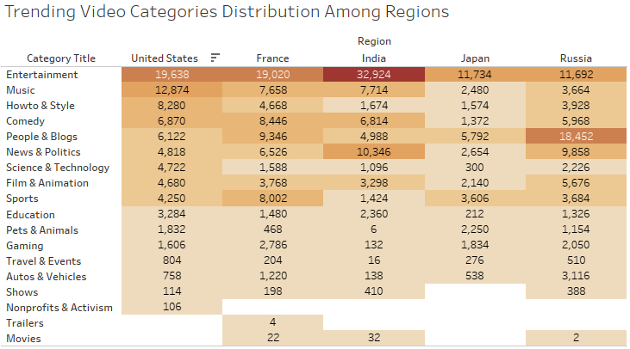
The most popular YouTube video category in the united states is Entertainment
The most popular YouTube video category in the United States is Entertainment, followed by Music and Howto & Style.
There are differences between the categories popular in the US and those popular elsewhere.
For example, in Russia, the most popular YouTube video category is People & Blogs. In India, the second most popular YouTube video category is News & Politics.

Slide 9
Conclusion
From our analysis we found that overall the most trending YouTube video categories on November 14th,2017 to June 14th,2018 were Entertainment, People & Blogs and Music. I would recommend overall to invest marketing resources into those categories. In addition, I would recommend investing in marketing the Howto & Style category because it’s the 3rd most trending category in the US which is our top country for YouTube views.

